Slide 1
Gartner DevOps
vCommander Positioning

Slide 2
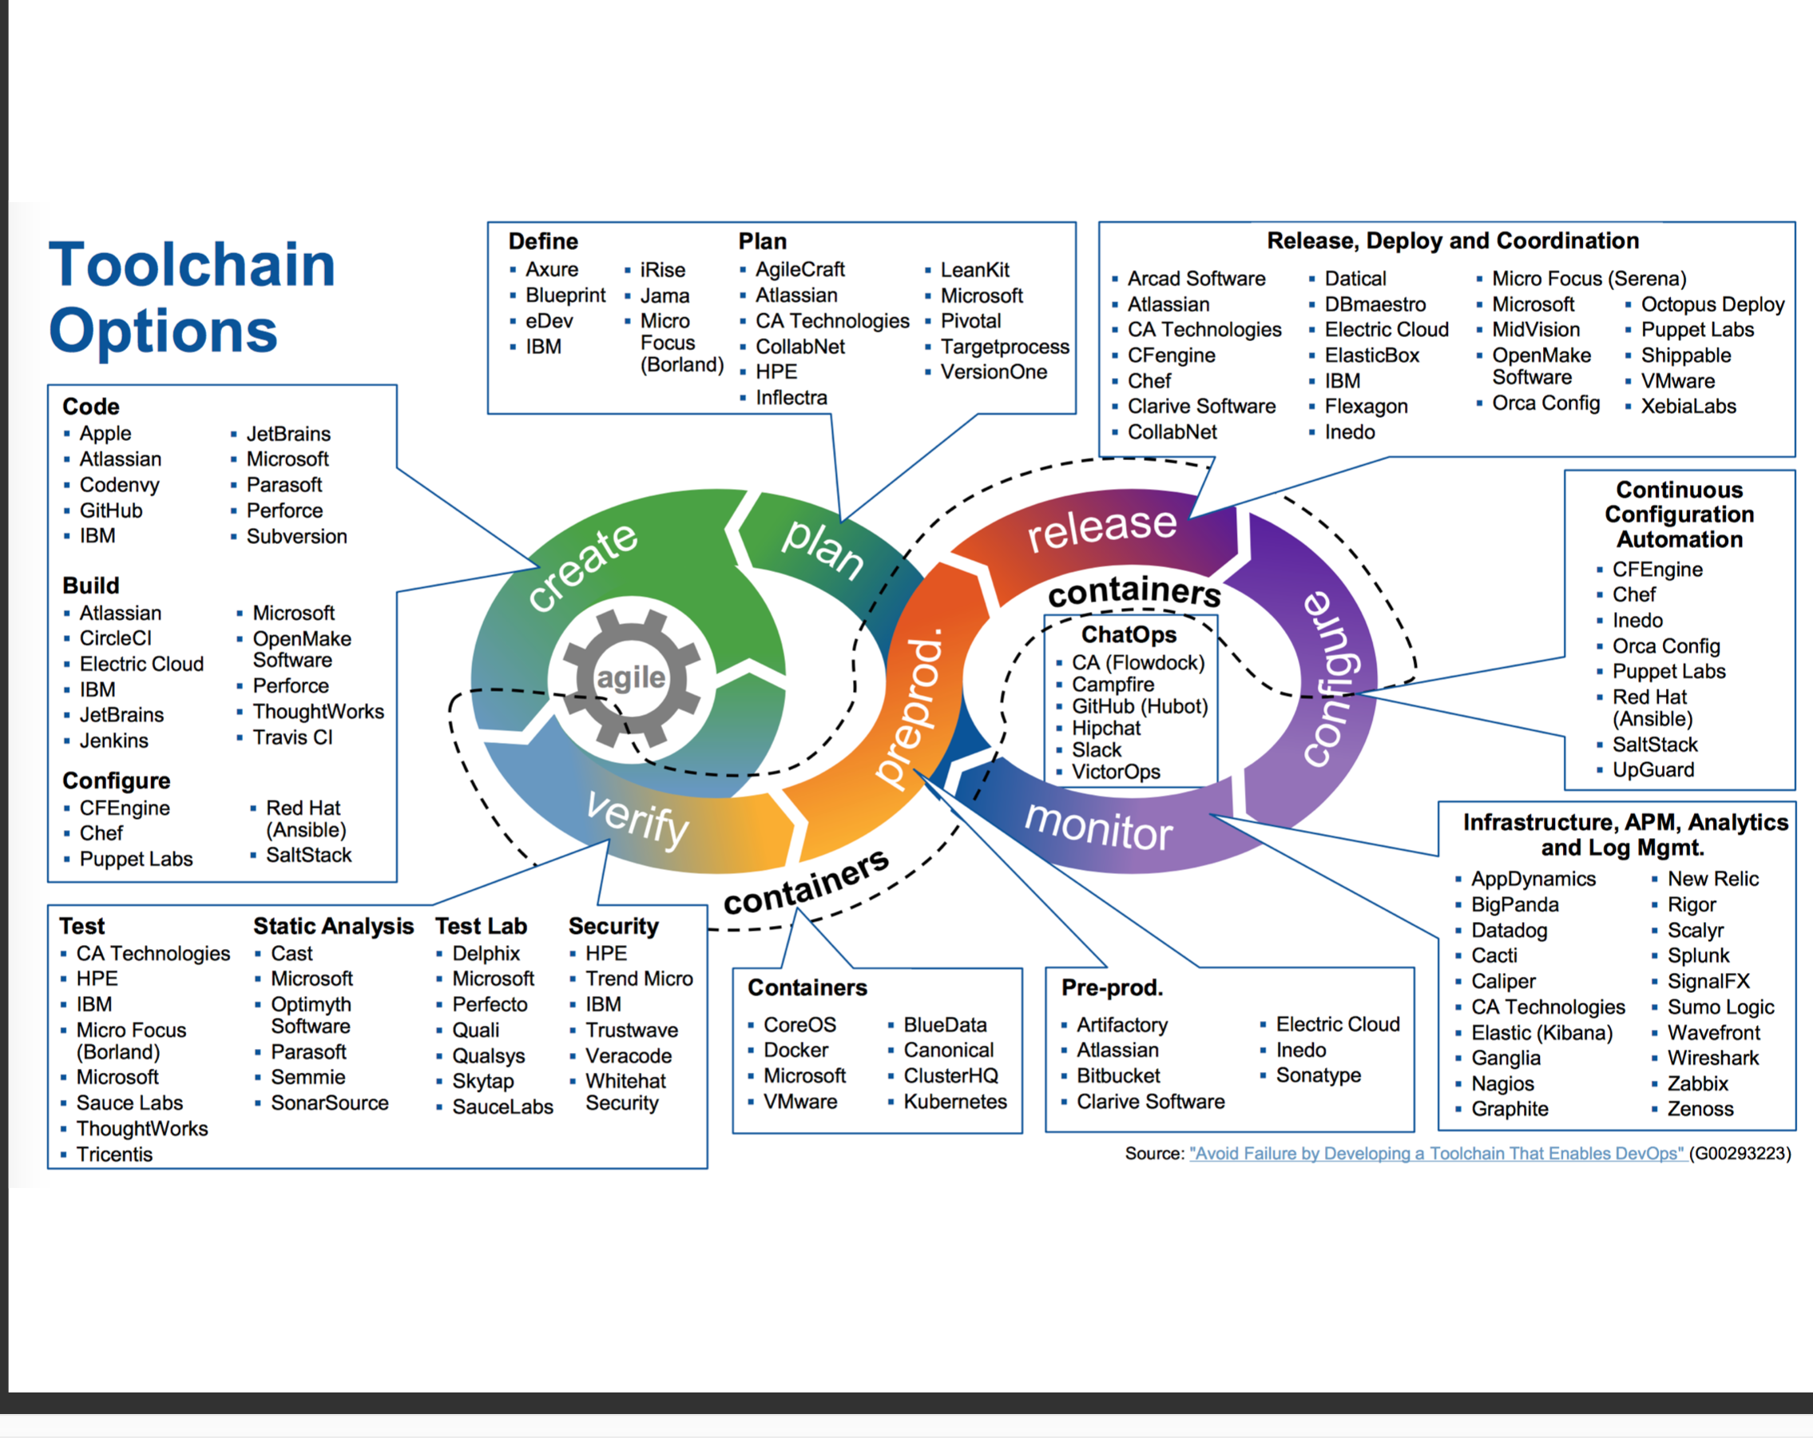
vCommander
vCommander
vCommander

Slide 3
Observations
Wide ranging set of products usually not associated with DevOps including ‘ChatOps’ -- Slack, ‘Infrastructure, APM, Analytics and Log Mgt’ – Kibana, WireShark
‘Fuzzy’ categories – How does ‘Test Labs’ differ from ‘Test’ category? The ‘APM, Analytics and Log Mgt’ is a broad category.
Some leading products are omitted – Hasicorp Terraform is omitted, Amazon AWS (CodePipeline, CodeBuild, CodeDeploy) is omitted.
Other products are placed in multiple categories – Electric Cloud is placed in ‘Build’, ‘Pre-Prod’, ‘Release, Deploy and Coordination’ categories

Slide 4
vCommmander
Closest to VMWare vRealize Codestream on DevOps positioning: Automation, and Continuous deployment
Gartner categories:
‘Release, Deployment and Coordination’ with vCommander focus on Intelligent placement, Continuous deployment, Blue/Green deployments
‘Pre-prod’ with vCommander focus on Provisioning, Blue/Green deployments
‘Containers’ with vCommander focus on Kubernetes validation and upgrade

